Slide 1
Modern API Protocols - Beyond REST(gRPC, GraphQL)
Protocols

Slide 2
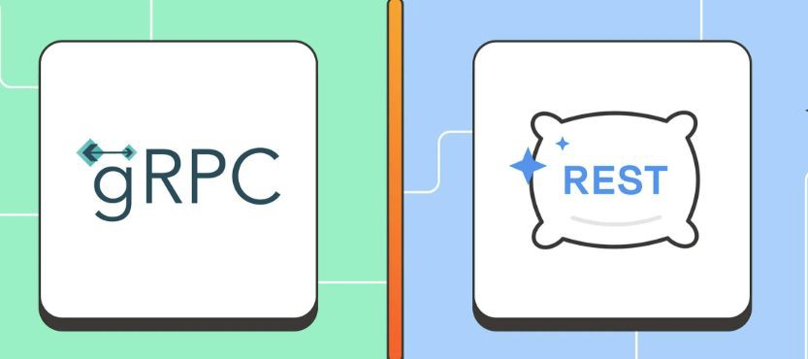
Why Do We Need More Than REST?
Limitations of REST APIs:
  Over-fetching & Under-fetching (Clients get too much or too little data).
  High Latency (Multiple requests needed for complex data).
  Not optimized for real-time communication (Polling required).
Need for modern solutions like gRPC & GraphQL to handle eﬃciency, ﬂexibility, and performance.

Slide 3
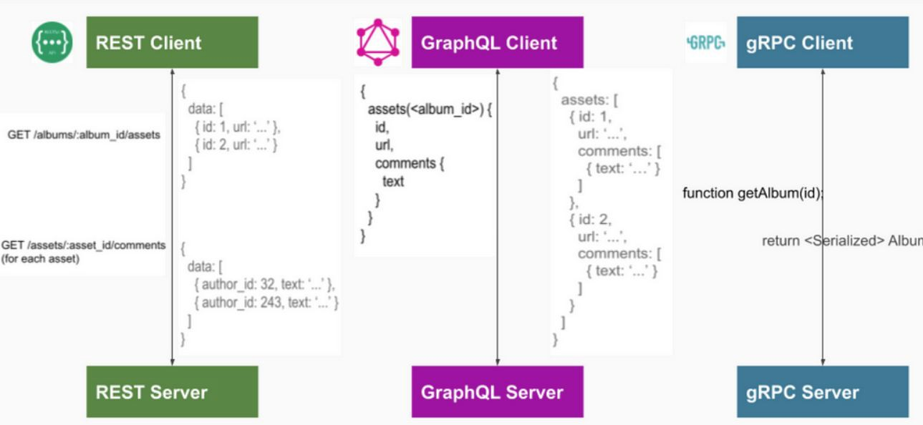
Introducing gRPC & GraphQL
gRPC: A high-performance, binary protocol optimized for microservices & real-time communication.
GraphQL: A ﬂexible query language that allows clients to fetch only the data they need.
Key Diﬀerences:
  gRPC = Fast, binary, microservices-focused
  GraphQL = Flexible, JSON-based,
frontend-optimized

Slide 4
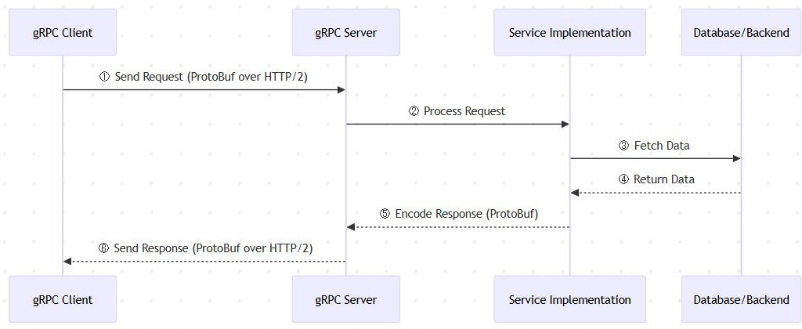
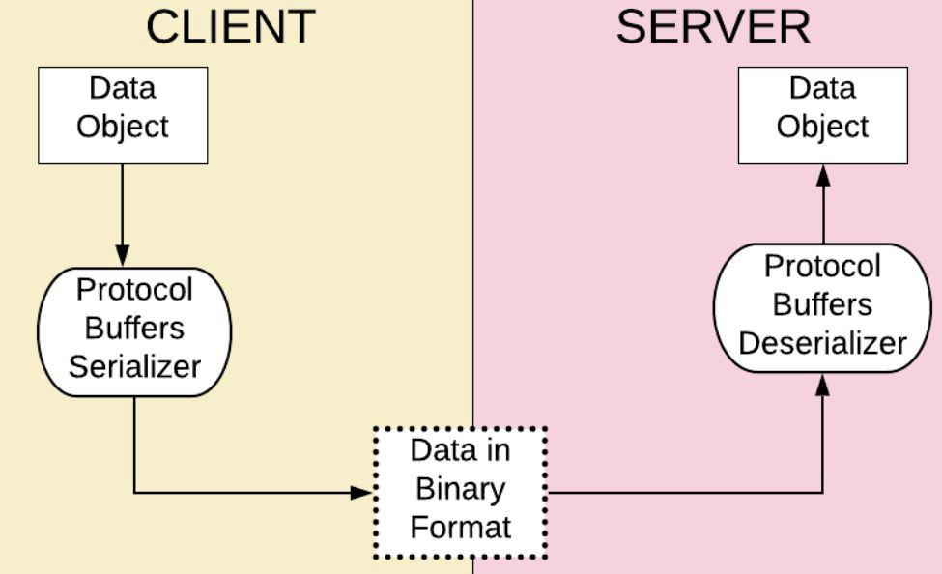
gRPC - How It Works?
gRPC is built on HTTP/2, allowing:
  Multiplexed requests (multiple calls over one connection).
  Compression (smaller payload sizes).
  Full-duplex streaming (real-time bidirectional communication).
Uses Protocol Buﬀers (ProtoBuf) for fast serialization (smaller & faster than JSON).

Slide 5
gRPC - Use Cases & When to Use
Microservices – Fast inter-service communication.
Real-time streaming – Full-duplex bidirectional data transfer.
IoT & Low-bandwidth applications – Eﬃcient binary communication.
Multi-language ecosystems – Auto-generated client & server code.

Slide 6
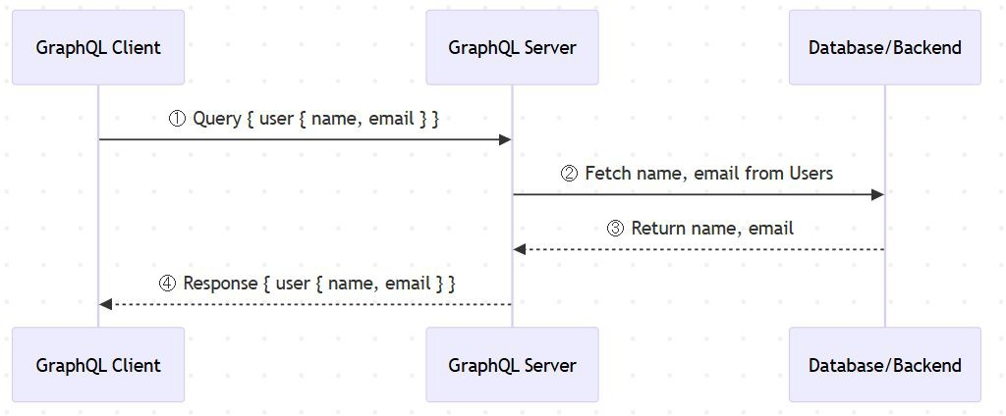
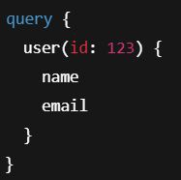
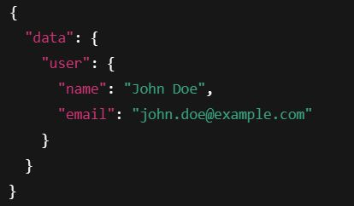
GraphQL - How It Works?
Instead of multiple REST endpoints, GraphQL has one endpoint where clients specify the data they need.
GraphQL Schema deﬁnes types & relationships between data.
Clients send queries → GraphQL server resolves ﬁelds dynamically.

Slide 7
GraphQL - Use Cases & When to Use
Frontend Optimization – Clients fetch exactly what they need.
Reducing API Requests – One query replaces multiple REST calls.
Mobile & Web Apps – Handles slow networks & multiple data sources.
Aggregating Data from Multiple Services – Simpliﬁes fetching data from diﬀerent databases or APIs.

Slide 8
Interview Questions on API Protocols
How would you compare REST, gRPC, and GraphQL?
When would you use gRPC over REST?
What are the trade-oﬀs of using GraphQL in a large-scale system?
How does gRPC handle authentication & security?
How do you scale GraphQL APIs eﬃciently?

Slide 9
Summary & Key Takeaways
gRPC → Best for microservices, real-time streaming, high-performance APIs.
GraphQL → Best for frontend-driven APIs, ﬂexible data fetching, and reducing over-fetching.
Choose based on use case – No one-size-ﬁts-all!
Be ready to justify your API choices in system design interviews!
What’s next:
  Summary & Practical Applications of protocols

Slide 10
Summary - Protocols
In this section, we explored key communication and API design protocols essential for system design:
  TCP & UDP - Understanding the Basics
  HTTP - The Backbone of the Web
  REST & RESTfulness - API Design Principles
  Real-Time Communication Protocols
  Modern API Protocols - Beyond REST
Next Up:
  Architectural Patterns
  We now shift focus to architectural patterns, which deﬁne how components interact in scalable systems.

